Slide 1
Equity Bank Integration Design
Customers request an ecomoto loan from Equity using their Equitel line in order to buy cooker.
Equity Bank grants the loan and in some way (Eazzy Pay Till - more clarity needed) , the money is deposited into KOKO merchant account.
Through Equity’s Jenga API integration, a notification callback with customer details e.g name, phone no., amount , transaction id e.t.c is triggered
Add money to customer KOKO Wallet by reconciling the customer details received and an existing account on KOKO Core.
Given that customers may already have an existing account with their Safaricom line, design allows an account to have more that one phone no. CSR’s to have a way to add numbers to user accounts.
Issues to solve
Send customer loan amount to KOKO Core so that it can be added to their balance as payment for cooker.
Know which customer an equitel no belongs to so the correct account is credited with the amount received from equity notification.
Associate many phone numbers to the same account so users can load credit from both Equitel and Mpesa numbers

Slide 2
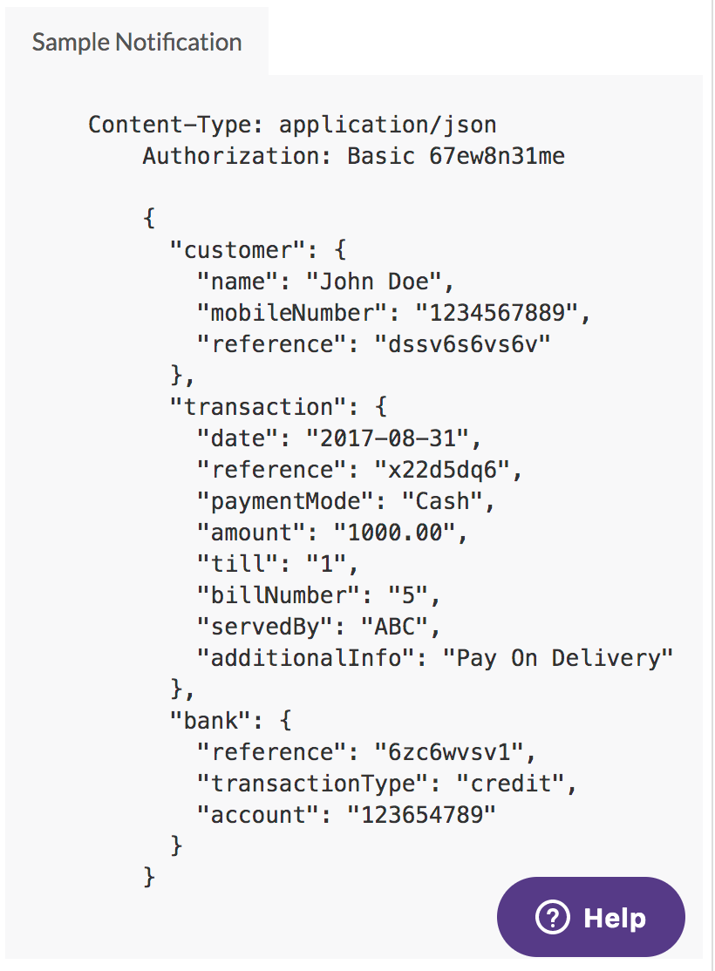
1. How To Receive Equity Customer Details
To receive notifications of monies in and out of Equity Bank account, enable alerts on KOKO Merchant Accounts in JengaHQ.
Register a KOKO Core callback URL(/equity/callback/alert - POST) where the notifications are sent to.
Further technical detail below:
We receive a notification from Equity
In the Equity request we receive the customer’s phone number
If that number exists in our database we use that to top up the customer’s wallet with amount received.
If that number does not exist in our database, we create an account for them automatically and store the money against that account.
Integrate Equity’s Jenga API, where if a customer is advanced an Ecomoto loan, Equity sends a payment confirmation via registered callback to KOKO.

Slide 3
2. Which Customer Account to Credit
Given that Equity agent will sign up the users using MyKOKO, expect that customer account will already exists in KOKO Core, when loan notification is received.
Query the account with such active phone number and credit with the received amount.

Slide 4
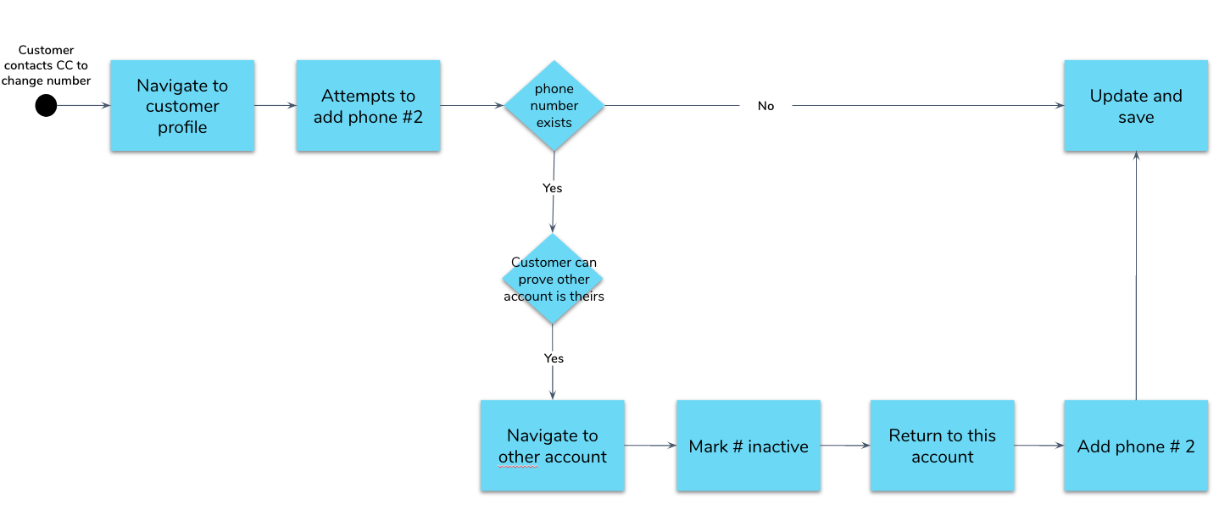
3. How To Associate Account With Multiple Phone No.s

Slide 5
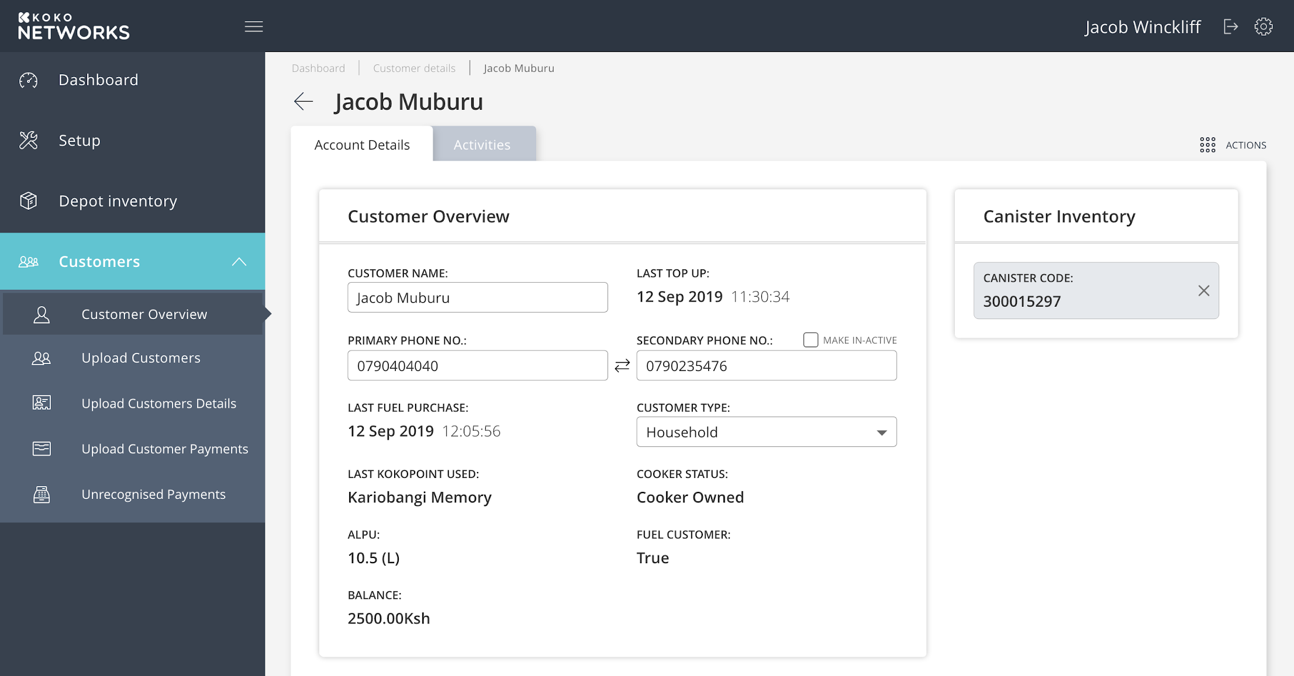
3. How To Associate Account With Multiple Phone No.s

Slide 6
Further technical details below:
Separate Phone Number from User table and create an additional table to manage Phone Numbers (User and Phone entities should have a one-many r/ship). (Done)
Phones numbers for a user are identified by the unique user id as the foreign key in the phone number table (Done)
Add inactive and primary flag - if a phone number is inactive this should allow another account to be set up with that phone number (Done).
Logging of phone number changes in the activity log in KC including phone number changed (e.g primary or secondary), previous data, new data. Use Events, can use existing PHONE_NUMBER_CHANGED with details captured in event information.
The API’s impacted to accommodate this change is /users/update-customer-details , which is used to update customer details in KC.

Slide 7
Technical Questions Answered
Technical Questions
JengaHQ allows us to register a callback API to KOKO Core which is used to notify us of incoming loan disbursements for customers?
Information would be passed in the API body for a loan disbursed to a user, which includes name, phone and transaction id.
Enable alerts feature in JengaHQ for callback to be notified
Callback should implement basic authentication for configured callback url and return a specific response (code 200) to JengaAP (used to determine success or failure their end)
JengaApi Callback does not support retries at this point in time. However, with transactionId , a payment verification can be performed using the JengaApi endpoint for payments validation.

Slide 8
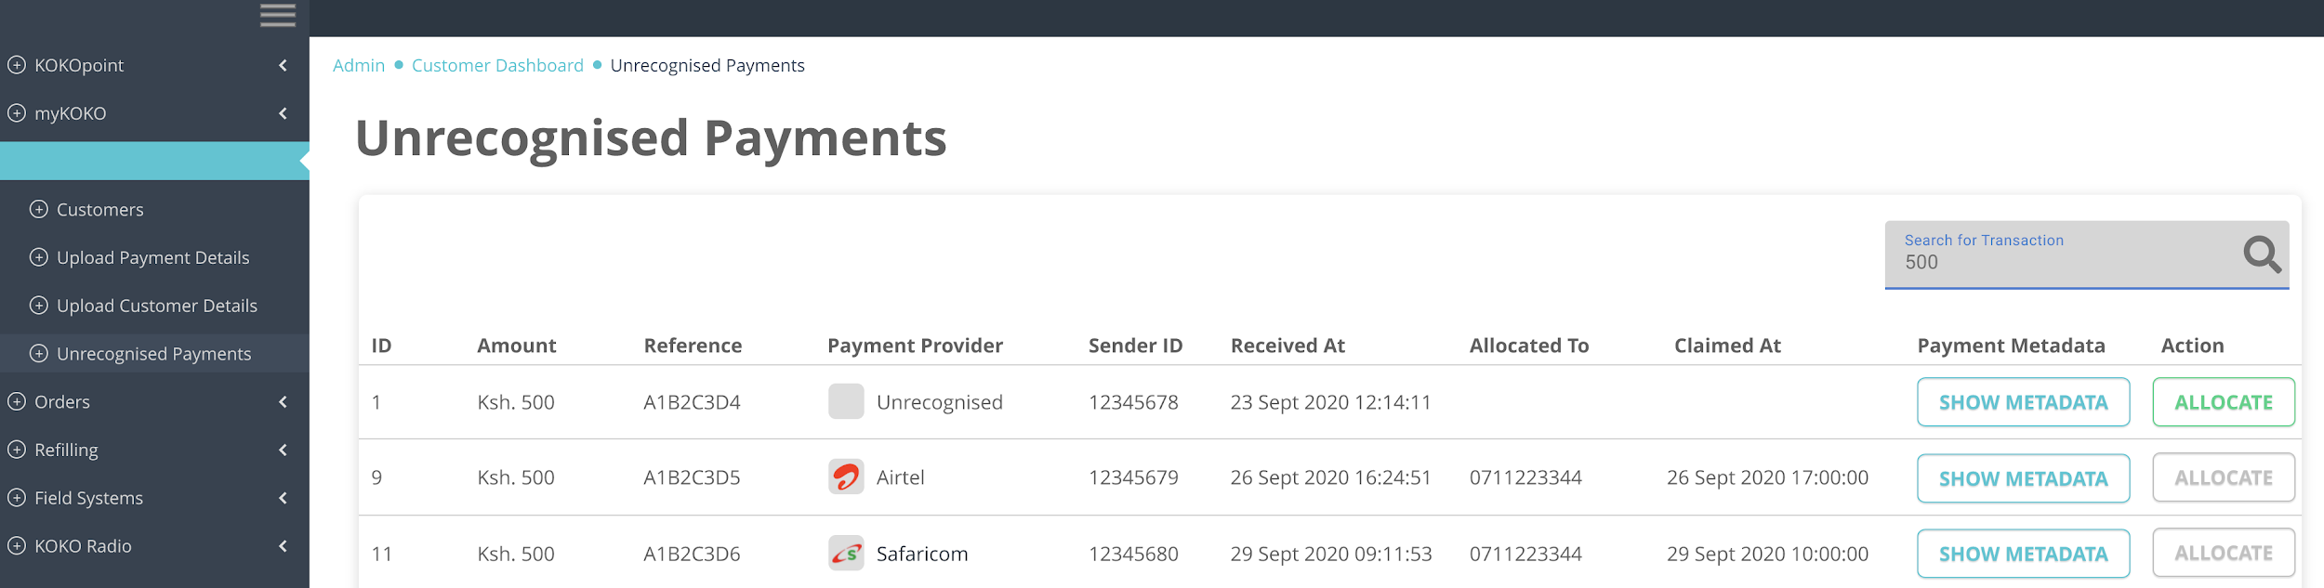
Handle Unrecognised Payments
Create an unrecognised payments table (sample UI below). Payments can be logged here until Customer Care can validate who the payment belongs to.
When customer calls in CC agent can create account and move funds over to the customer.
https://xd.adobe.com/view/409adfa8-9f5f-49b4-9628-8a879da9fa43-15c9/?fullscreen

Slide 9
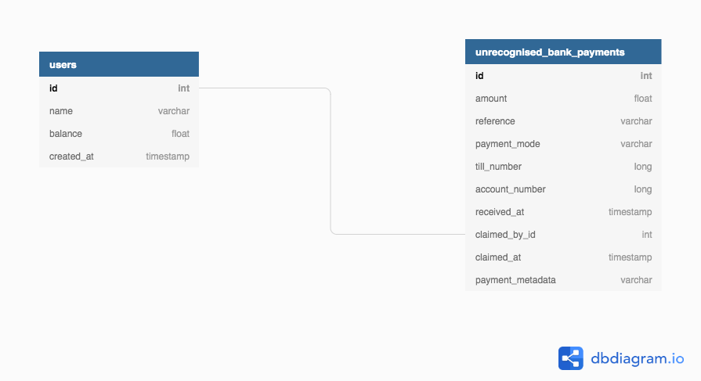
Database Design (Schema)

Slide 10
Scenarios
# | Scenario | Method of payment | What happens
1 | Existing customer with account but we do not know their Equity bank account ID | Ecomoto loan from Equity | Money is received in unrecognised payments table
2 | Existing customer with account but we do know their Equity bank account ID | Ecomoto loan from Equity | CSR manually claim funds for customer from the unrecognised payments table
3 | New customer without KOKO account | Ecomoto loan from Equity | Money is received in unrecognised payments table

Slide 11
Scenarios (Cont)
When CSR’s transfer claimed funds to claimants wallet, we create preorder, send sms notification,marked the unrecognised payment as claimed - the same way we do for Safaricom topups.
If it is an existing customer, credit that account with the claimed funds
If it is a new customer, CSR would create their account and claim against the new customer account.

Slide 12
Project Status
These are the features completed;
Users having multiple numbers - created functionality to allow adding more numbers upto a limit of 4, and toggle there primary and active states
Added Equity topup configurations on Odoo
Added functionality to record and keep track of unrecognised payments, untill they are claimed.
Created unrecognised payments page where KOKO admin can allocate payments to specific customer account.

Slide 13
What’s pending:
The payment verification feature has not been done, since we were informed that the endpoints have a problem. (Kept getting invalid reference id even when a valid one is used)
End to end testing for the loan process hasn’t been done. We need to see behaviour when an actual loan is dispatched from customer and notification sent to KOKO Core.
NB: Code published on bitbucket on separated branch to store it.

Slide 14
Otieno Rowland | o.odhiambo2@kokonetworks.com

